Slide 1


Slide 2
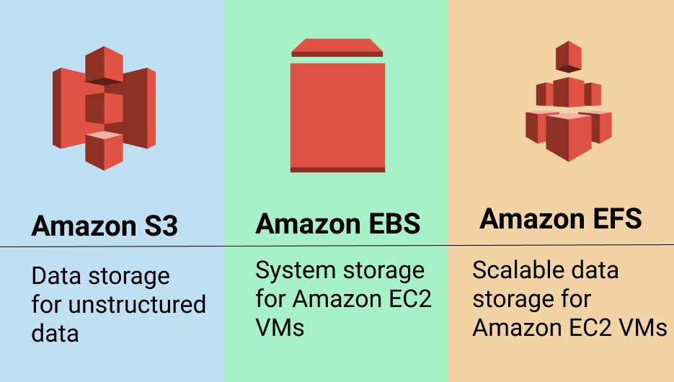

Slide 3
Block STORAGE VS OBJECT STORAGE
Block storage is suitable for the transactional databases , random read/write loads and structured database storage.
Block storage divides the data in evenly sized blocks (data chunks) for instance , file is spilt intoeven sized blocks.
Blocks are referred by index number for their location in EBS.
Data blocks stored in a block storage would not contain metadata (datatypes , creation date , modified date).
Block storage only keeps the address (index) not care what is in that block ,just how to retrieve it when required.

Slide 4
Object Storage
Object storage store the files as a whole and does not divide them.
In object storage an object is
The file data itself
Its metadata
Object global unique id
The object global unique ID is a unique Identifier for the object it can be the object name itself and it must be unique such that is can be retrieved disregarding where its physical storage location is.
Object storage cannot be mounted as a drive.
Example of object storage : AWS S3 , facebook , dropbox.

Slide 5
Simple STORAGE SERVICE (S3)
S3 is a storage for the internet.
It has a simple webservice interface for simple storing and retrieving any amount of data anytime from anywhere on the internet.
S3 has a distributed data store architecture where objects are stored in multi locations.( Min 3 location in same region)
Data is stored in a bucket.
A bucket is a fast container of objects.
Max Capacity of a bucket is 5TB.
You can create folders in your Bucket (available through console).

Slide 6
You cannot create nested buckets.
Bucket ownership is non-transferrable
S3 bucket is region specific.
You can have upto 100 buckets per account.
Note : Object storage can be accessed through internet.
EBS storage can be accessed through instance only .

Slide 7
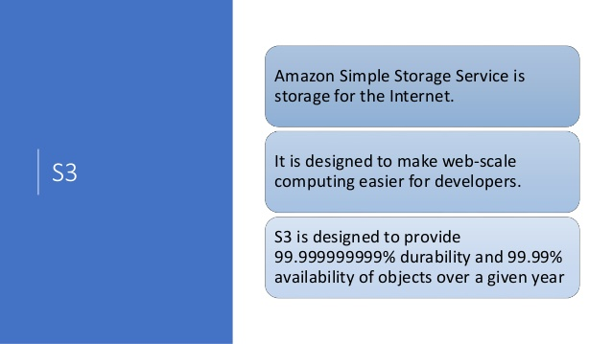

Slide 8
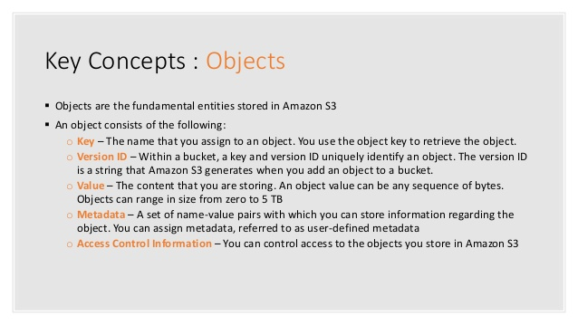

Slide 9
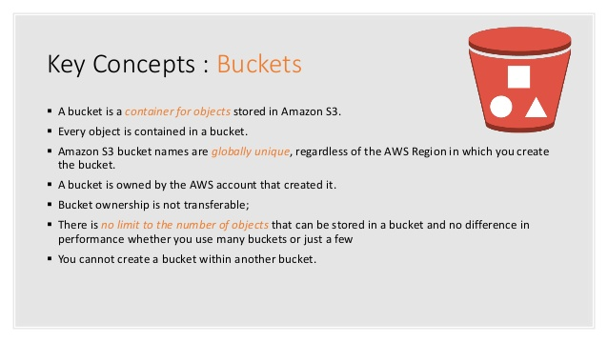

Slide 10
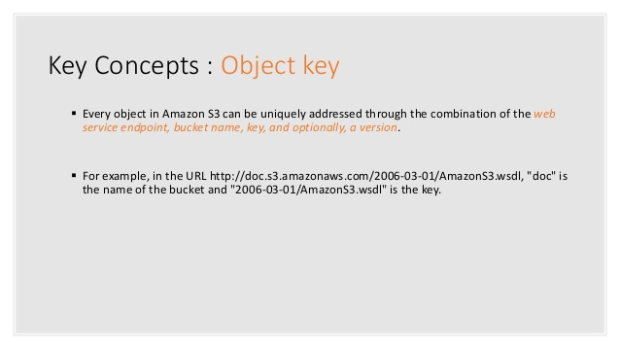

Slide 11
S3 Bucket naming rules
S3 bucket names ( keys) are globally unique across all AWS regions.
Bucket names cannot be change after they are created .
If a bucket is deleted its name becomes available again to you or other account to use.
Bucket names must be at least 3 and no more than 63 characters.
Bucket names are part of the URL used to access a bucket.
Bucket name must be a series of one or more lables(xyz.bucket) , there should be no space in between.

Slide 12
Bucket name can contain lowercase numbers and hypen , cannot use uppercase letters.
Buckets name should not be an Ip Address.
Each label must store and end with a lowercase letter or a number.
By default , buckets and its objects are private , By default only owner can access the bucket.
S3 Policy Generator (all object access): http://awspolicygen.s3.amazonaws.com/policygen.html
The name in S3 is simply two parts:
Bucket region endpoint/bucket name.
Ex: for S3 bucket named mybuckets in Europe West Region.

Slide 13
S3 Buckets SUBRESOURCES
Sub resources for S3 bucket includes
1. Lifecycle : to decide an object lifecycle management .
2.website : to hold configurations related to static website hosted on s3 bucket.
3.Versioning : keep objects version as it changes.
4.Access control list : Bucket Policies.

Slide 14
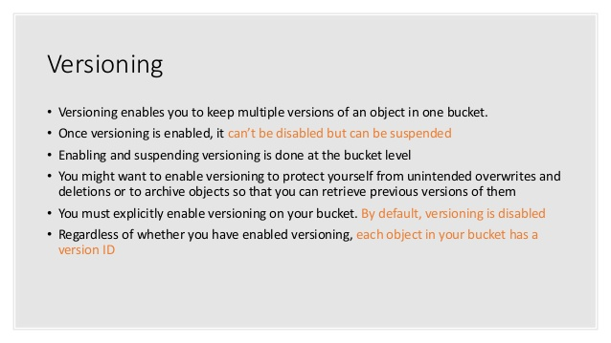

Slide 15
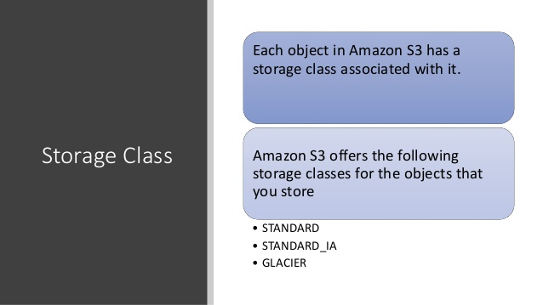

Slide 16
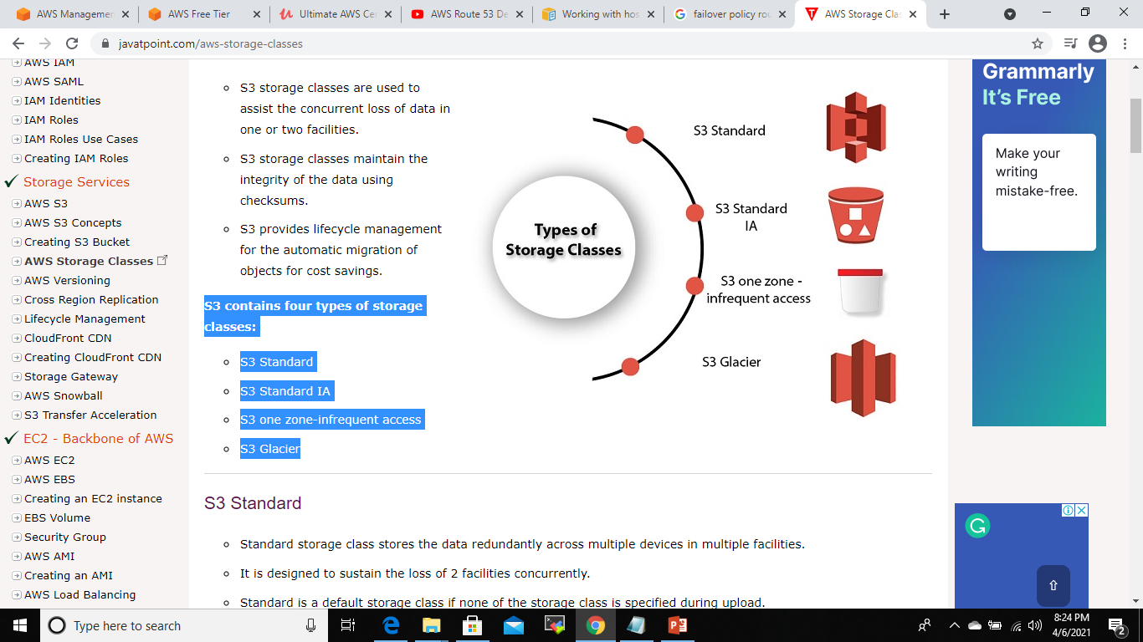
S3 storage classes are used to assist the concurrent loss of data in one or two facilities.
S3 storage classes maintain the integrity of the data using checksums.
S3 provides lifecycle management for the automatic migration of objects for cost savings.
S3 contains four types of storage classes:
S3 Standard
S3 Standard IA
S3 one zone-infrequent access
S3 Glacier

Slide 17
1 . S3 Standard
Standard storage class stores the data redundantly across multiple devices in multiple facilities.
It is designed to sustain the loss of 2 facilities concurrently.
Standard is a default storage class if none of the storage class is specified during upload.
It provides low latency and high throughput performance.
It designed for 99.99% availability and 99.999999999% durability

Slide 18
2 . S3 Standard IA
IA stands for infrequently accessed.
Standard IA storage class is used when data is accessed less frequently but requires rapid access when needed.
It has a lower fee than S3, but you will be charged for a retrieval fee.
It is designed to sustain the loss of 2 facilities concurrently.
It is mainly used for larger objects greater than 128 KB kept for atleast 30 days.
It provides low latency and high throughput performance.
It designed for 99.99% availability and 99.999999999% durability

Slide 19
3. S3 one zone-infrequent access
S3 one zone-infrequent access storage class is used when data is accessed less frequently but requires rapid access when needed.
It stores the data in a single availability zone while other storage classes store the data in a minimum of three availability zones. Due to this reason, its cost is 20% less than Standard IA storage class.
It is an optimal choice for the less frequently accessed data but does not require the availability of Standard or Standard IA storage class.
It is a good choice for storing the backup data.
It is cost-effective storage which is replicated from other AWS region using S3 Cross Region replication.
It has the same durability, high performance, and low latency, with a low storage price and low retrieval fee.
It designed for 99.5% availability and 99.999999999% durability of objects in a single availability zone.
It provides lifecycle management for the automatic migration of objects to other S3 storage classes.
The data can be lost at the time of the destruction of an availability zone as it stores the data in a single availability zone.

Slide 20
4. S3 Glacier
S3 Glacier storage class is the cheapest storage class, but it can be used for archive only.
You can store any amount of data at a lower cost than other storage classes.
S3 Glacier provides three types of models:
Expedited: In this model, data is stored for a few minutes, and it has a very higher fee.
Standard: The retrieval time of the standard model is 3 to 5 hours.
Bulk: The retrieval time of the bulk model is 5 to 12 hours.
You can upload the objects directly to the S3 Glacier.
It is designed for 99.999999999% durability of objects across multiple availability zones

Slide 21
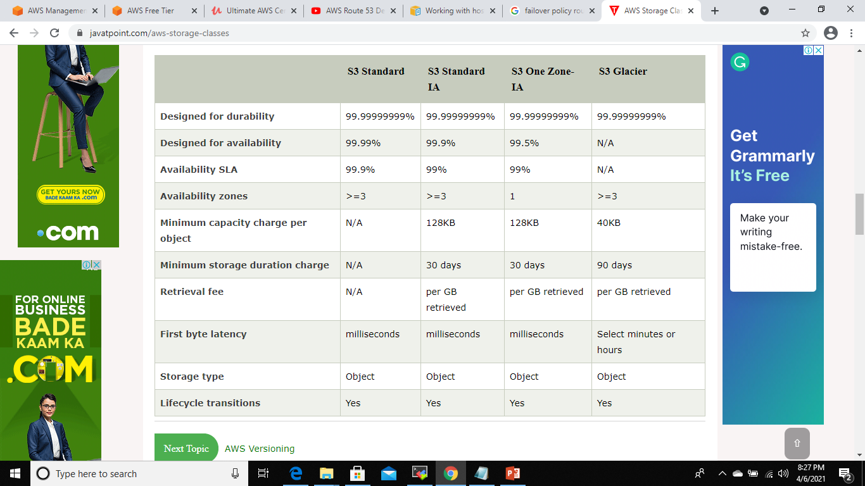

Slide 22
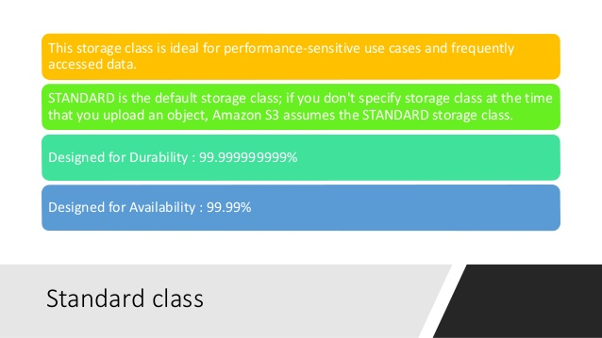

Slide 23
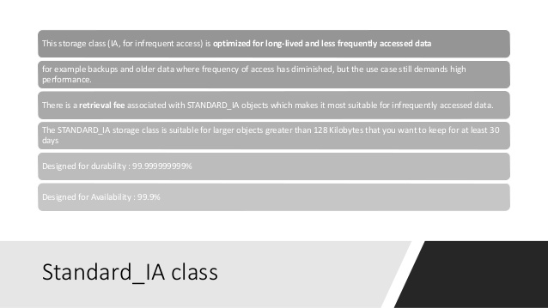

Slide 24
